Slide 1
Accommodating and Communicating about Episodic Disabilities (ACED) A partnership to deliver workplace tools and resources to sustain the employment of people with chronic, episodic conditions
Presented at the Disability at Work in Canada
2020 Conference
Monique A.M. Gignac, PhD
Scientific Co-Director & Senior Scientist
Institute for Work & Health, Toronto, Canada
Professor, Dalla Lana School of Public Health,
University of Toronto

Slide 2
ACED Team
Project Director: Monique Gignac
Research Team:
Partners:
Dorcas Beaton
Curtis Breslin
Renée-Louise
Franche
Emma Irvin
Arif Jetha
Joy MacDermid
Ron Saunders
William Shaw
Peter Smith
Aaron Thompson
Emile Tompa
Dwayne Van Eerd
Julie Bowring
Sabrina Tonima
Sara Macdonald
Institute for Work & Health
Arthritis Society
Crohn’s & Colitis Canada
Mindful Employer Canada
Ontario Ministry of Labour, Training & Skills Development
Realize
University of Toronto
Canadian Mental Health Association
Workplace Strategies for Mental Health
Multiple Sclerosis Society of Canada

Slide 3
Working with a Chronic, Episodic Condition
Decisions whether to disclose health information at work are often stressful and complex
Many workers:
Are not familiar with privacy legislation that protects them from having to disclose disease diagnoses and symptoms
Are unsure how to talk about health needs or how to focus on job-related activity limitations
Workplace representatives who provide support highlight:
Challenges related to workplace cultures, misgivings about others involved in communication-support processes, and conditions when workers choose not to share health needs but workplace performance and interactions are affected

Slide 4
Working with a Chronic, Episodic Condition
Bottom lines:
Workers want guidance on whether to communicate, their options, and what, when and how to share information.
A consistent and comprehensive approach to assessing job demands and support needs is needed

Slide 5
ACED Activities
Resource Scan of existing publicly available materials providing advice related to disclosure and workplace accommodations
New Research
- Two large surveys n ~ 1600 & 3,000
- Focus groups with older workers
- One-to-one interviews with workplace representatives providing support (e.g., including supervisors, HR, union representatives, labour lawyers)
- student practicum opportunities
Gignac, M.A.M., Bowring, J., Jetha, A., Beaton, D.E., Breslin, F.C., Franche, R.-L., et al., (2020). Disclosure, privacy and workplace accommodation of episodic disabilities: Organizational perspectives on disability communication-support processes to sustain employment. Journal of Occupational Rehabilitation. https://doi.org/10.1007/s10926-020-09901-2
Gignac, M.A.M., Jetha, A., Martin Ginis, K.A., Ibrahim, S. (2020). Does it matter what your reasons are when deciding to disclose (or not disclose) a disability at work? The association of workers’ approach and avoidance goals with perceived positive and negative workplace outcomes. Under review.
Van Eerd, D., Bowring, J., Jetha, A., Breslin, F. C., Gignac, M. A. M. (2020). Online resources supporting workers with chronic episodic disabilities: An environmental scan. International Journal of Workplace Health Management. Revise and resubmit.

Slide 6
ACED Tools and Resources
Job Demands and Accommodation Planning Tool (JDAPT)
Communication Decision-Making Tool

Slide 7
ACED Partnership Aims
personalized
interactive
evidence-based
Workplace tools, resources & training
easily accessed
Enhance work sustainability for people with episodic disabilities
ACED materials will
Be responsive to needs and preferences
Promote discussion
Facilitate brainstorming
Be feasible and broadly applicable
Adopt a disability prevention and support framework
Emphasize skills and abilities
Improve short and long-term workplace outcomes
We will NOT give advice

Slide 8
Job Demands and Accommodation Planning Tool (JDAPT)
Worker version: self-assessment of job demands & challenges; identifies potential self-management, support, and accommodation strategies
Organizational version: can be completed by workplace staff & employee for planning
Physical tasks
(5 areas)
Mental or “thinking” tasks (cognitive demands)
(6 areas)
Working with others (interpersonal work demands)
(5 areas)
Working conditions (environmental work demands)
(8 areas)
Not a formal functional assessment, job analysis or cognitive demands analysis tool; not intended as a performance review

Slide 9
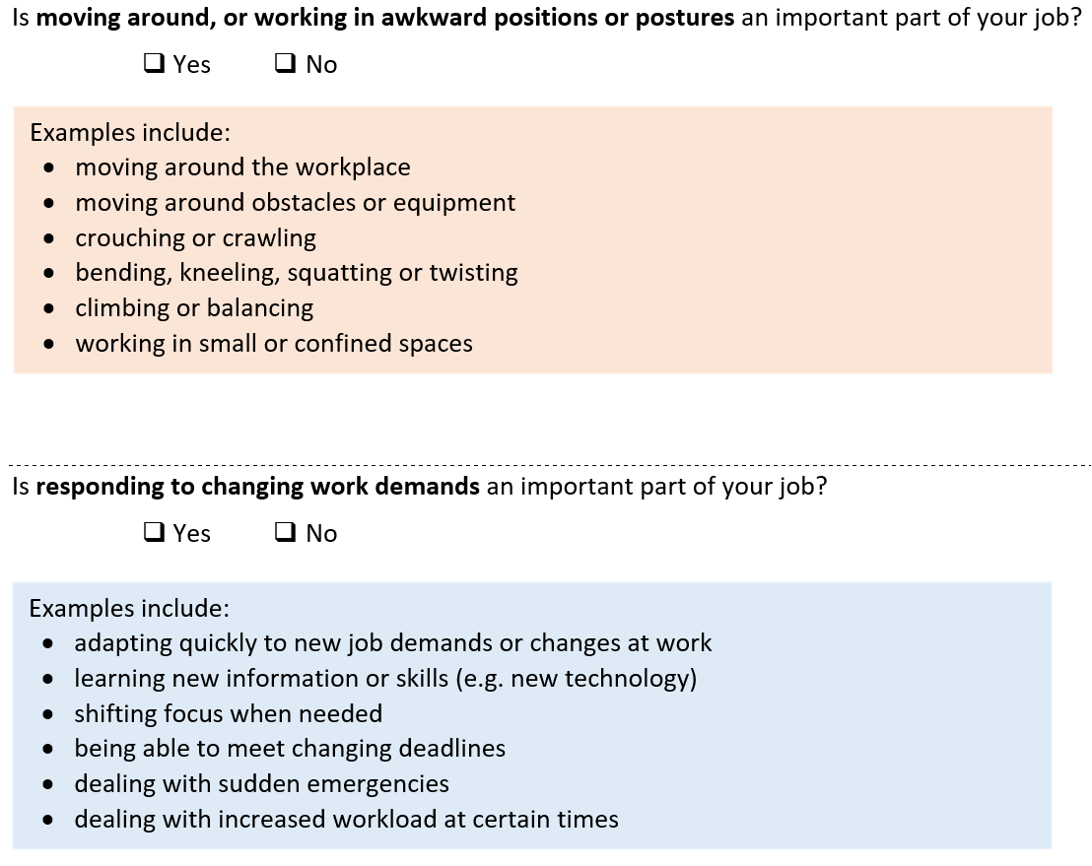
JDAPT Example Questions

Slide 10
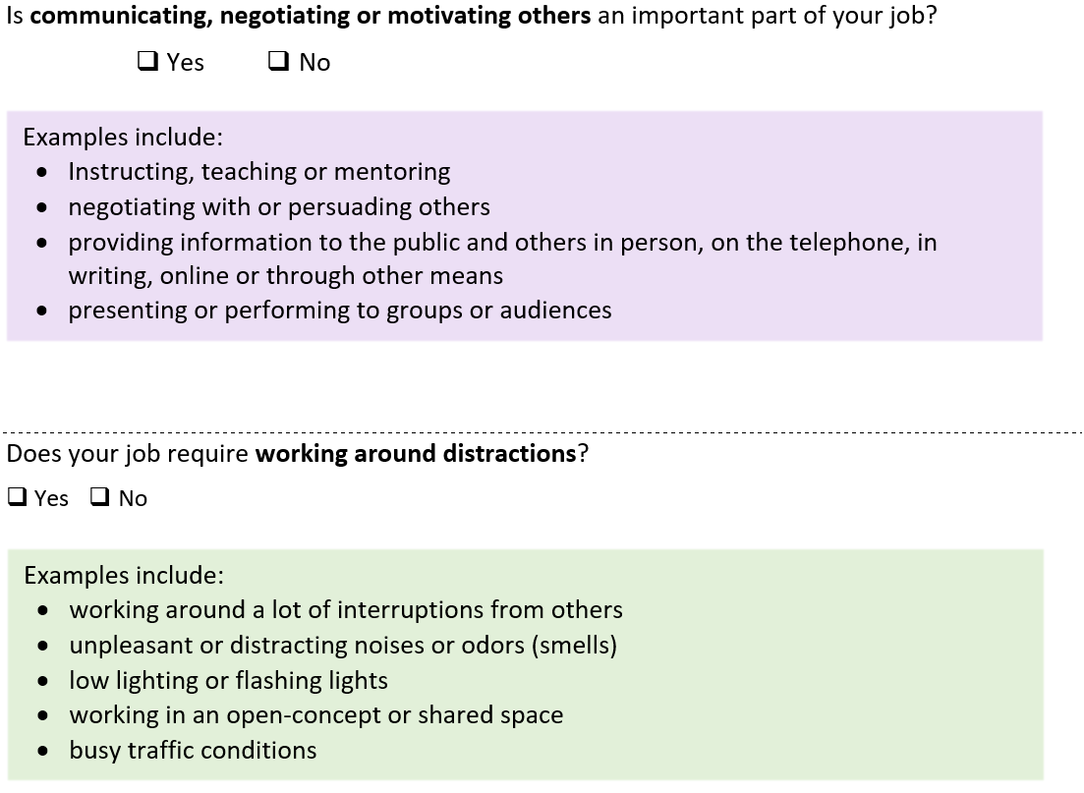
JDAPT Example Questions

Slide 11
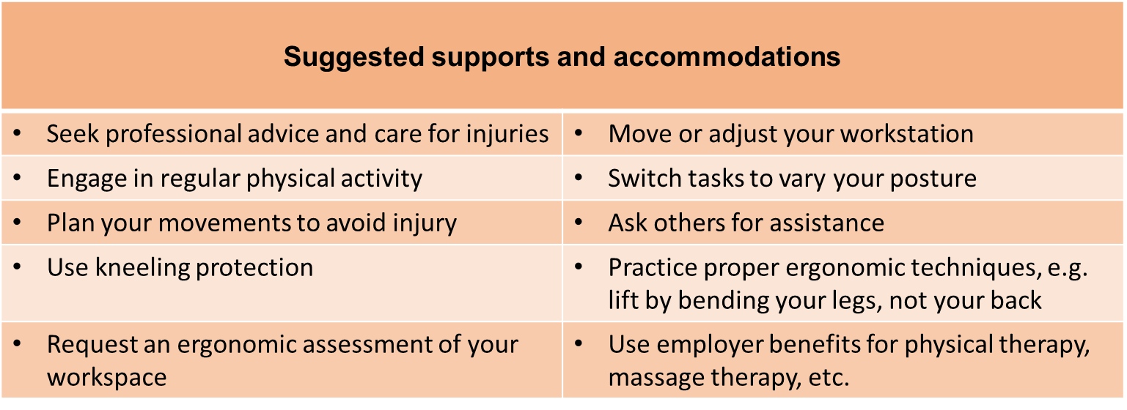
Example Supports and Accommodations
Physical Job Demand:
Moving around, or working in awkward positions or postures

Slide 12
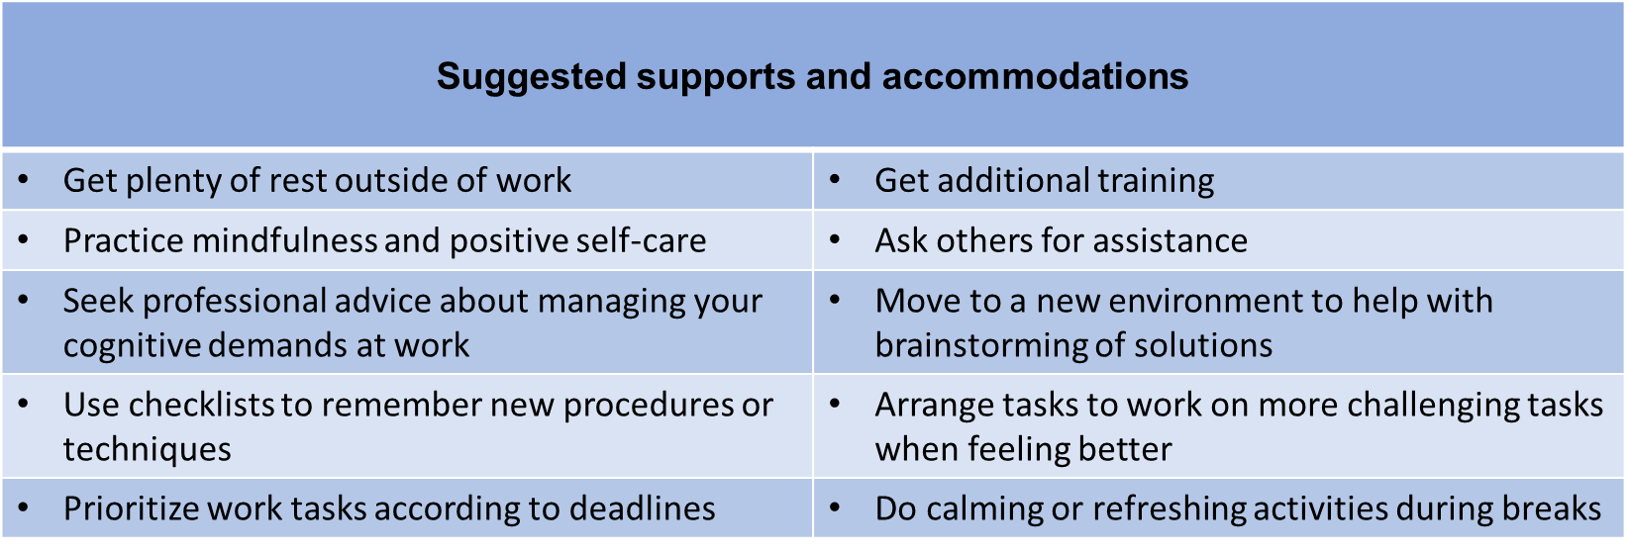
Example Supports and Accommodations
Cognitive Job Demand: Responding to changing work demands

Slide 13
Pilot Testing the JDAPT
Testing focused on:
Ease of understanding
Interpretation of items
Item relevance for different episodic conditions, occupations, and personal characteristics like gender and age

Slide 14
Pilot Testing the JDAPT
In-depth pilot testing and cognitive debriefing of the JDAPT conducted with:
~ 20 research experts
~ 12 partner representatives from different health charities
- 46 workers living with diverse types of episodic health conditions
- 23 organizational representatives (e.g., supervisors, HR personnel, disability managers)
- Included individuals from different sized organizations, job types and job sectors (e.g., sales/service, education, manufacturing, health, government, financial, transportation, hospitality)

Slide 15
Pilot Testing the JDAPT
Sample Characteristics | N (%)
Gender: Women Men | 54 (78.3) 15 (21.7)
Age (years): 18-34 35-49 50 or more | 24 (34.8) 29 (42.0) 16 (23.2)
Job Sector: Financial, insurance, government, business Education, health, sciences, arts Sales, services, retail Construction, utilities, agriculture, manufacturing | 23 (33.3) 31 (44.9) 8 (11.6) 7 (10.2)

Slide 16
Pilot Testing the JDAPT
Takes about 14 minutes to complete (range = 4 - 38 minutes)
Participants liked the JDAPT overall and reported high need for it
Participants living with episodic conditions reported somewhat more usefulness than organizational representatives
Feedback was mostly to clarifying some instructions and adding new examples
Next steps: The JDAPT is being put online and more testing will occur in early 2021

Slide 17
ACED Communication Decision-Making Tool
Five Broad Topic Areas in Development:
What is your current work situation? Why are you thinking about sharing personal health information at work? (asking yourself some hard questions)
What are your goals in sharing or not sharing information?
What matters to you? What do you need to understand about yourself in making a decision?
What do you need to consider about your job and your organization?
When should you say something? What do you need to think about now and in the future?

Slide 18
Questions? Comments?​ Interested in getting involved?
​Visit our website:​ https://aced.iwh.on.ca/

