Slide 1
An Institutional Analysis of Workplace Accommodations in the Ontario Non-profit Sector
Poster Presentation by Alexis Buettgen
Disability and Work in Canada 2020 Virtual Conference
November 25 & 26 and December 1 & 2

Slide 2
Methodology
Institutional analysis drawing from institutional ethnography
Methods:
Interviews with employees with disabilities and senior leaders
Textual analysis of organizational documents and laws, policies, legislation
Participants
6 senior leaders, and
9 front line employees with disabilities from
3 non-profit service providing organizations

Slide 3
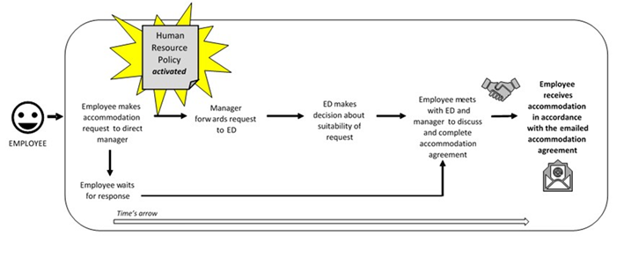
The Social Organization of the Accommodation Process at Organization A

Slide 4
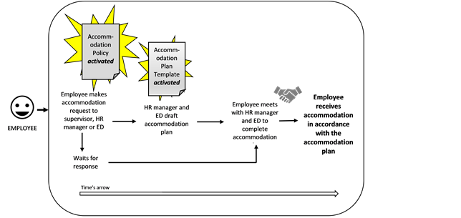
The Social Organization of the Accommodation Process at Organization B

Slide 5
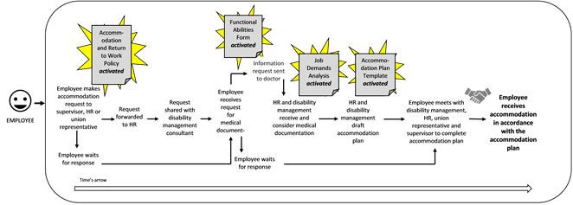
The Social Organization of the Accommodation Process at Organization C

Slide 7
Conclusions and Implications
Transform the workplace rather than the person
Value subjective embodied experiences of disability
The non-profit sector is a potential site for inclusive employment

Slide 8
Thank you for listening and/or watching!
For more information about this study you can:
Read my dissertation online here
Watch and listen to a previous webinar about this research here.
Contact me by email at: alexis.buettgen@eviance.ca; or a.buettgen@gmail.com

